Slide 1
Queues
Lecture # 8

Slide 2

Introduction
A queue structure is well suited for problems in computer science that require data to be processed in the order in which it was received.
A queue is a specialized list with a limited number of operations in which items can only be added to one end and removed from the other.
A queue is also known as a first-in, first-out (FIFO) list.
New items are inserted into a queue at the back while existing items are removed from the front.

Slide 3
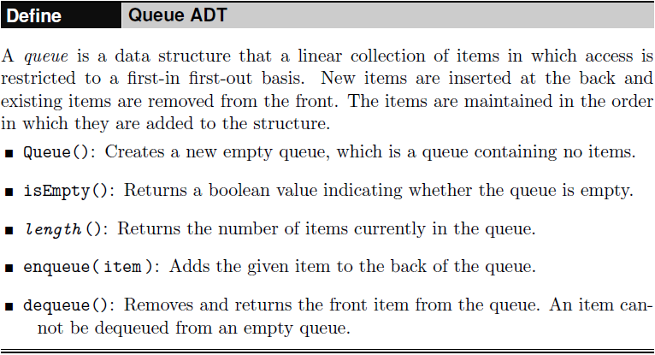
The Queue ADT

Slide 4
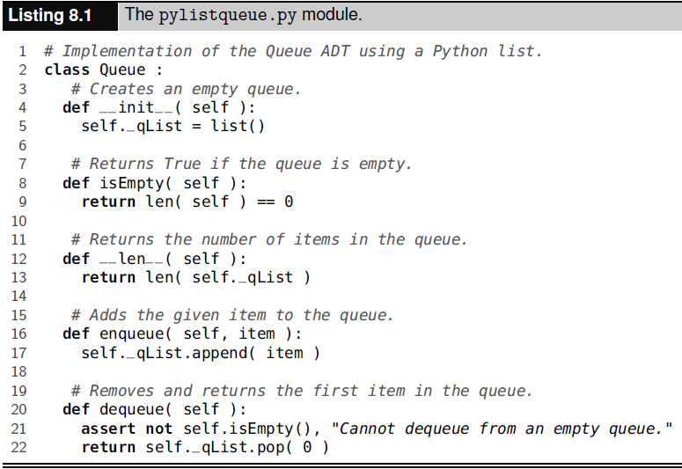
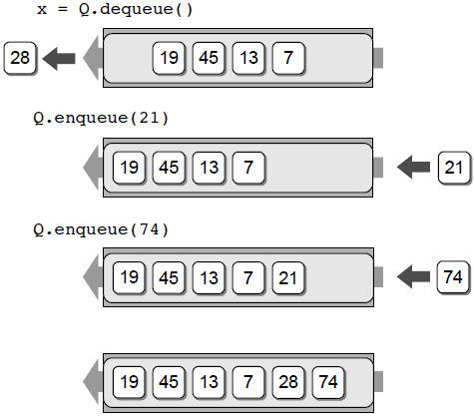
Implementing the Queue - Using a Python List

Slide 5
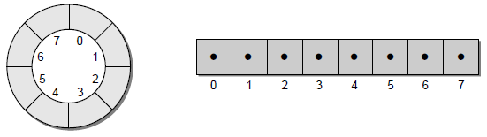
Implementing the Queue - Using a Circular Array
The list-based implementation of the Queue ADT is easy to implement, but it requires linear time for the enqueue and dequeue operations.
We can improve these times using an array structure and treating it as a circular array. A circular array is simply an array viewed as a circle instead of a line.
A circular array allows us to add new items to a queue and remove existing ones without having to shift items in the process.

Slide 6
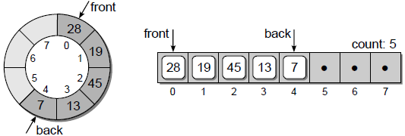
Implementing the Queue - Using a Circular Array
To implement a queue as a circular array, we must maintain a count field and two markers.
The count field is necessary to keep track of how many items are currently in the queue since only a portion of the array may actually contain queue items.
The markers indicate the array elements containing the first and last items in the queue.

Slide 7
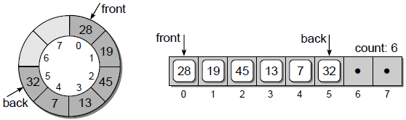
Implementing the Queue - Using a Circular Array
New items are added to the queue by inserting them in the position immediately following the back marker.
The marker is then advanced one position and the counter is incremented to reflect the addition of the new item.
For example, suppose we enqueue value 32 into the sample queue. The back marker is advanced to position 5 and value 32 is inserted:

Slide 8
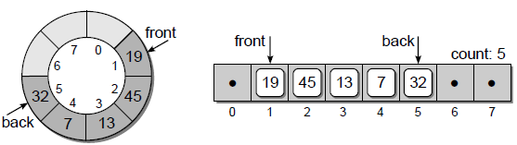
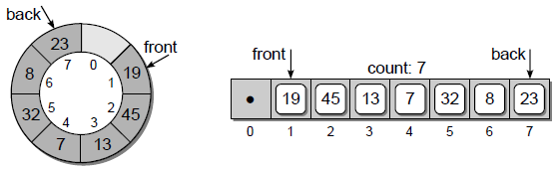
Implementing the Queue - Using a Circular Array
To dequeue an item, the value in the element marked by front will be returned and the marker is advanced one position:
Now, suppose we add values 8 and 23 to the queue. These values are added in the positions following the back marker:

Slide 9
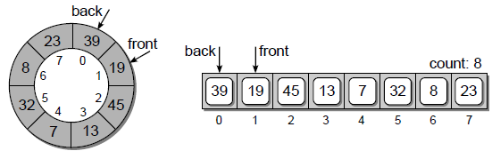
Implementing the Queue - Using a Circular Array
What happens if value 39 is added?
Since we are using a circular array, the same procedure is used and the new item will be inserted into the position immediately following the back marker.

Slide 10
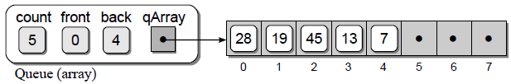
Implementing the Queue - Using a Circular Array
The constructor creates an object containing four data fields, including the counter to keep track of the number of items in the queue, the two markers, and the array itself.
The array is created with maxSize elements as specified by the argument to the constructor.
The two markers are initialized so the first item will be stored in element 0.
This is achieved by setting _front to 0 and _back to the index of the last element in the array maxSize-1.
When the first item is added, _back will wrap around to element 0 and the new value will be stored in that position.

Slide 11
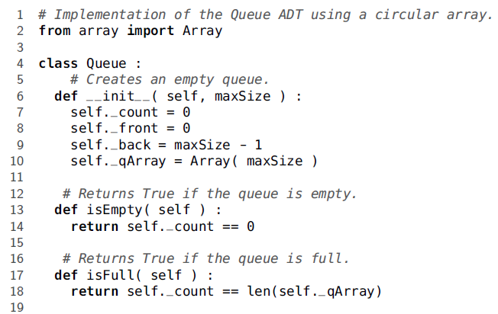
Implementing the Queue - Using a Circular Array

Slide 12
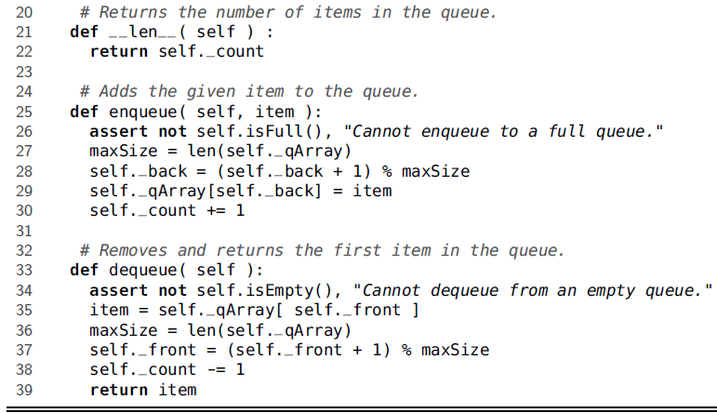
Implementing the Queue - Using a Circular Array

Slide 13
Implementing the Queue - Using a Circular Array
Run Time Analysis
The circular array implementation provides a more efficient solution than the
Python list.
The operations all have a worst-case time-complexity of O(1) since the array items never have to be shifted.
The circular array does introduce the drawback of working with a maximum-capacity queue. Even with this limitation, it is well suited for some applications.

Slide 14
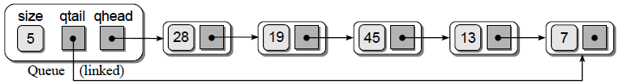
Implementing the Queue - Using a Linked List
A major disadvantage in using a Python list to implement the Queue ADT is the expense of the enqueue and dequeue operations.
The circular array implementation improved on these operations, but at the cost of limiting the size of the queue.
A better solution is to use a linked list consisting of both head and tail references.
Adding the tail reference allows for quick append operations that otherwise would require a complete traversal to find the end of the list.

Slide 15
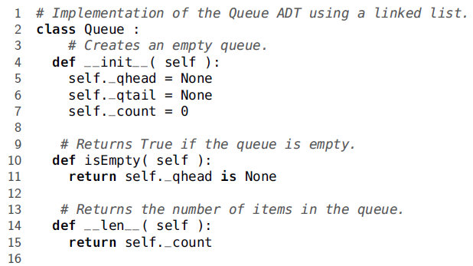
Implementing the Queue - Using a Linked List

Slide 16
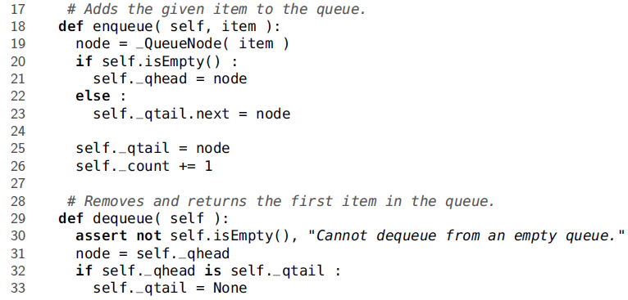
Implementing the Queue - Using a Linked List

Slide 17
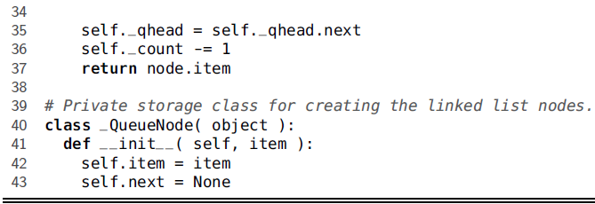
Implementing the Queue - Using a Linked List

Slide 18
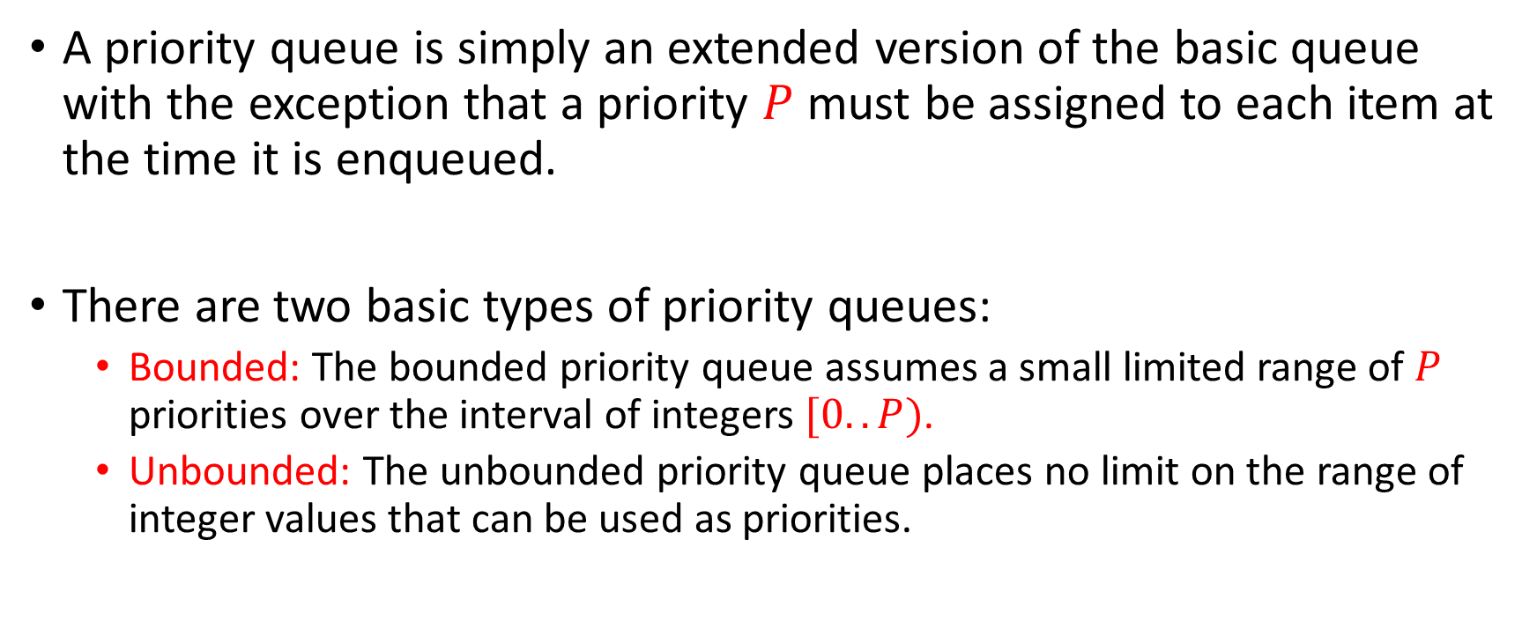
Priority Queues
A priority queue is simply an extended version of the basic queue with the exception that a priority $P$ must be assigned to each item at the time it is enqueued.
There are two basic types of priority queues:
Bounded: The bounded priority queue assumes a small limited range of $P$ priorities over the interval of integers $[0..P)$.
Unbounded: The unbounded priority queue places no limit on the range of integer values that can be used as priorities.

Slide 19
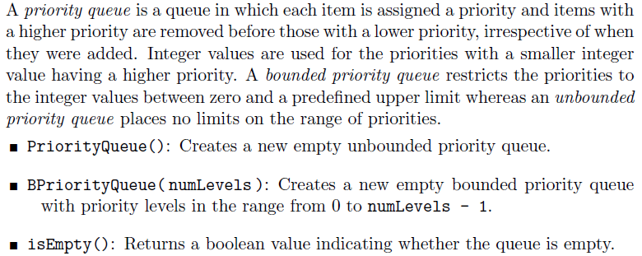
Priority Queues

Slide 20
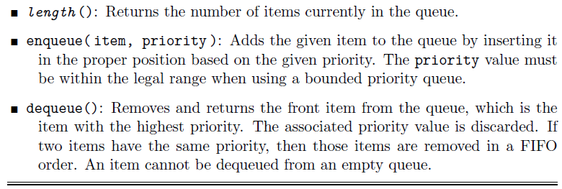
Priority Queues

Slide 21
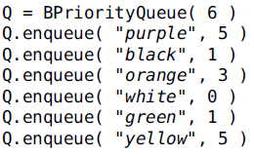

Priority Queues - Example

Slide 22
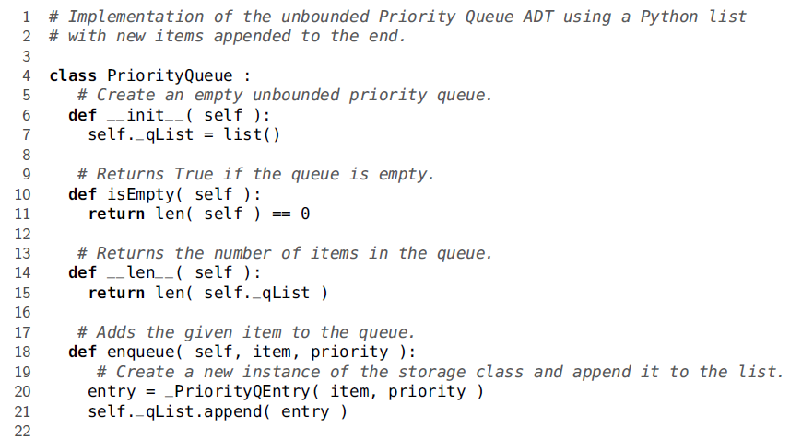
Priority Queues - Unbounded

Slide 23
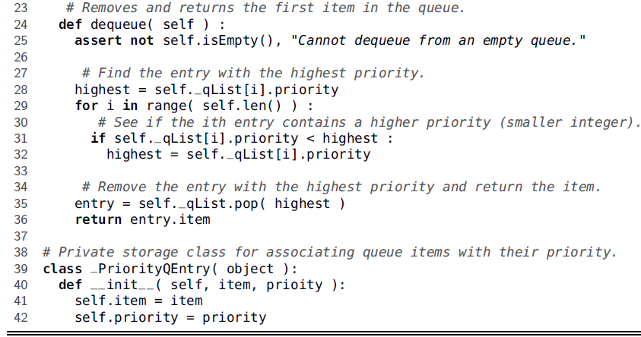
Priority Queues - Unbounded
def dequeue(self): """Looks for the entry with highest priority and dequeue""" assert not self.isEmpty(), "Empty queue" index = 0 highest = self._qList[index].priority for i in range(len(self)): if self._qList[i].priority < highest: highest = self._qList[i].priority index = i entry = self._qList.pop(index) return entry.item

Slide 24
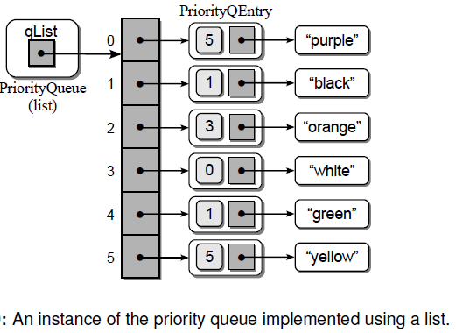
Priority Queues - Unbounded

Slide 25
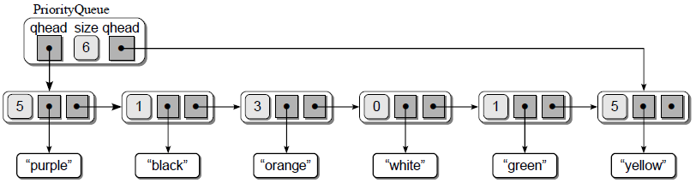
Priority Queues – Linked List implementation
qtail

Slide 26
Queues – Linked List implementation
#Implementation of the Queue ADT using a linked list class Queue: def __init__(self): self._qhead = None self._qtail = None self._count = 0 #Returns true if the queue is empty def isEmpty(self): return self._qhead is None #Returns the number of items def __len__(self): return self._count #adds the given item to the queue def enqueue(self, item): node = _QueueNode(item) if self.isEmpty(): self._qhead = node else: self._qtail.next = node
self._qtail = node self._count += 1
#Removes and returns the first item def dequeue(self): assert not self.isEmpty(), "Can not be empty" node = self._qhead if self._qhead is self._qtail: self._qtail = None self._qhead = self._qhead.next self._count -= 1 return node.item class _QueueNode(object): def __init__(self, item): self.item = item self.next = None

Slide 27
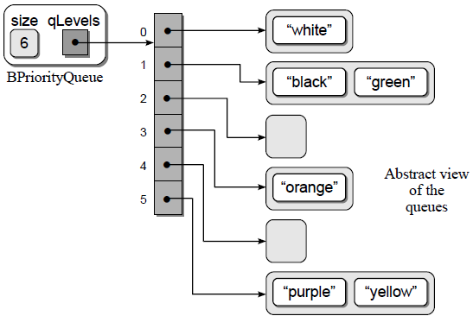
Priority Queues – Bounded Priority Queue
Implementation of the priority queue using an array of queues.

Slide 28
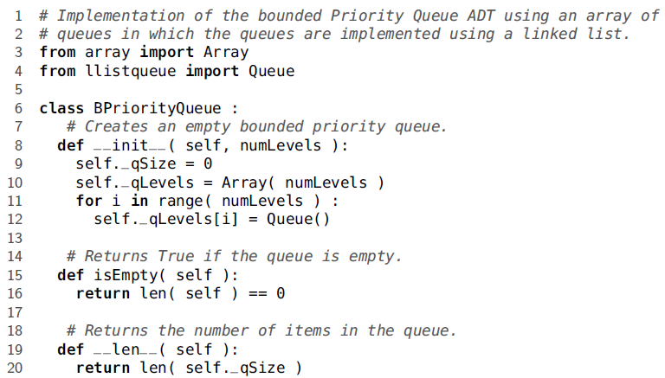
Priority Queues – Bounded Priority Queue

Slide 29
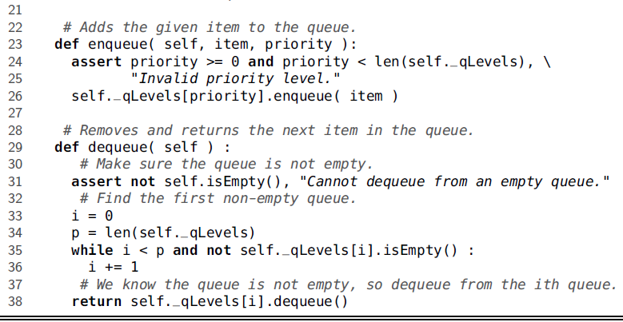
Priority Queues – Bounded Priority Queue

Slide 30
Computer Simulations
Computer simulations are simply computer applications that have been designed to represent and appropriately react to the significant events occurring in the system.
Simulations can allow humans to study certain behaviors or experiment with certain changes and events in a system to determine the appropriate strategy.
For example, an airline may want to know how many ticket agents are needed at certain times of the day in order to provide timely service. Having too many agents will cost the airline money, but too few will result in angry customers.

Slide 31
Application: Airline Ticket Counter
Simulating an airline ticket counter, or any other queuing system where customers stand in line awaiting service, is very common.
A queue structure is used to model the queuing system in order to study certain behaviors or outcomes.
We can model a queuing system by constructing a discrete event simulation. Such as,
customer arrival,
the start or conclusion of a transaction,
or customer departure.
The simulation is time driven and performed over a preset time period.

Slide 32
Application: Airline Ticket Counter
A simulation is commonly designed to allow the user to supply parameters that define the conditions of the system.
For a discrete event simulation modeling a queuing system, these parameters include:
The length of the simulation given in number of time units. The simulation typically begins at time unit zero.
The number of servers providing the service to the customers. We must have at least one server.
The expected service time to complete a transaction.
The distribution of arrival times, which is used to determine when customers arrive.

Slide 33
Application: Airline Ticket Counter
Finally, a set of rules are defined for handling the events during each tick of the clock.
To determine the average time customers must wait in line before being served, there are three rules:
Rule 1: If a customer arrives, he is added to the queue. At most, one customer can arrive during each time step.
Rule 2: If there are customers waiting, for each free server, the next customer in line begins her transaction.
Rule 3: For each server handling a transaction, if the transaction is complete, the customer departs and the server becomes free.

Slide 34
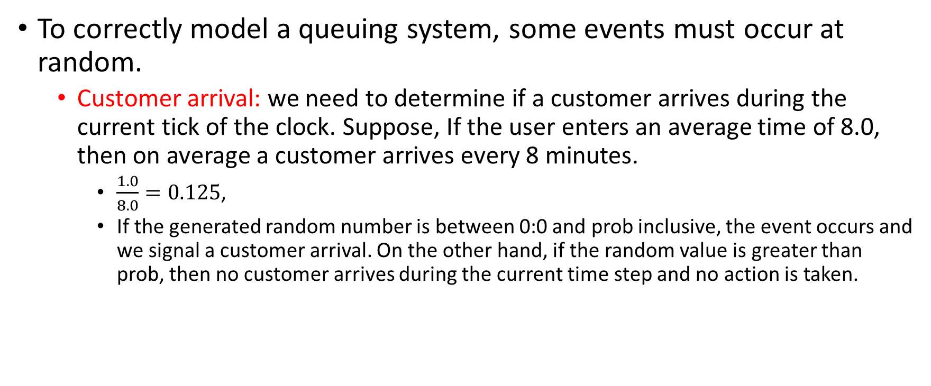
Application: Airline Ticket Counter
To correctly model a queuing system, some events must occur at random.
Customer arrival: we need to determine if a customer arrives during the current tick of the clock. Suppose, If the user enters an average time of 8.0, then on average a customer arrives every 8 minutes.
$\frac{1.0}{8.0}=0.125$,
If the generated random number is between 0:0 and prob inclusive, the event occurs and we signal a customer arrival. On the other hand, if the random value is greater than prob, then no customer arrives during the current time step and no action is taken.

Slide 35
Application: Airline Ticket Counter
System Parameters
The program will prompt the user for the queuing system parameters:
Number of minutes to simulate: 25
Number of ticket agents: 2
Average service time per passenger: 3
Average time between passenger arrival: 2
For simplicity we use minutes as the discrete time units.
The program will then perform the simulation and produce the following output:
Number of passengers served = 12
Number of passengers remaining in line = 1
The average wait time was 1.17 minutes.

Slide 36
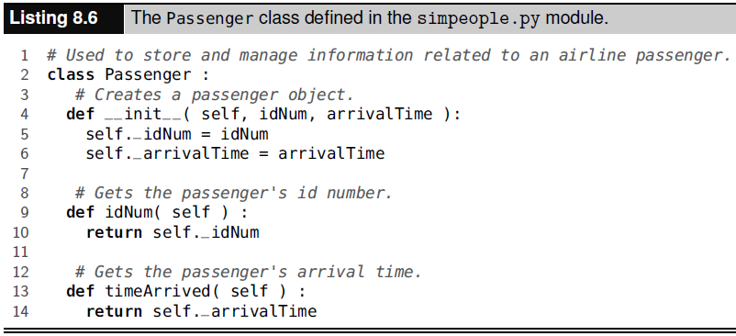
Application: Airline Ticket Counter

Slide 37
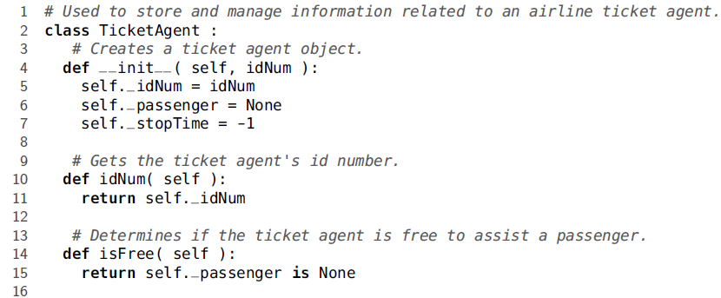
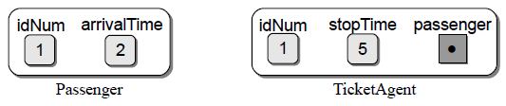
Application: Airline Ticket Counter

Slide 38
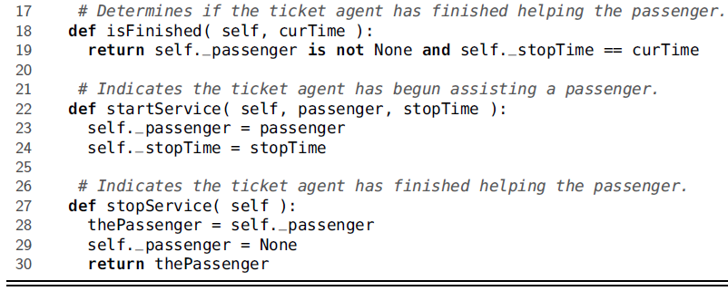
Application: Airline Ticket Counter

Slide 39
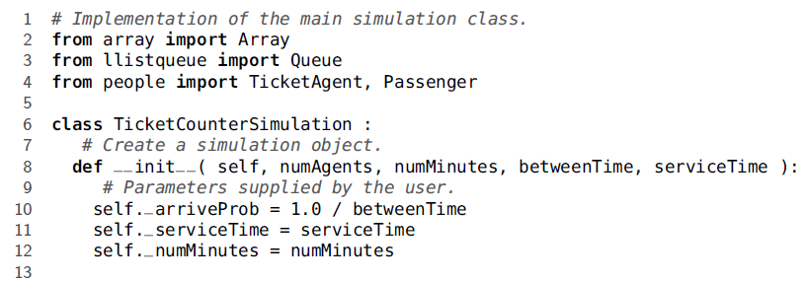
Application: Airline Ticket Counter

Slide 40
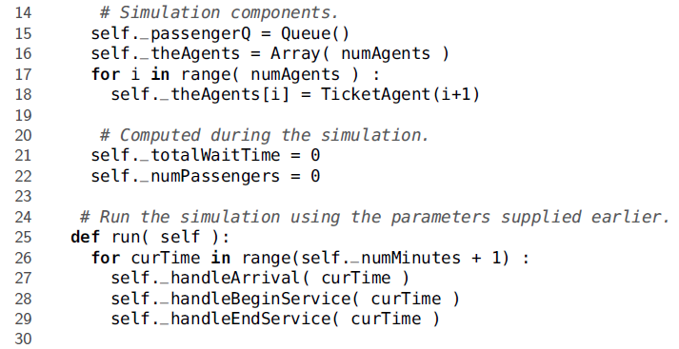
Application: Airline Ticket Counter

Slide 41
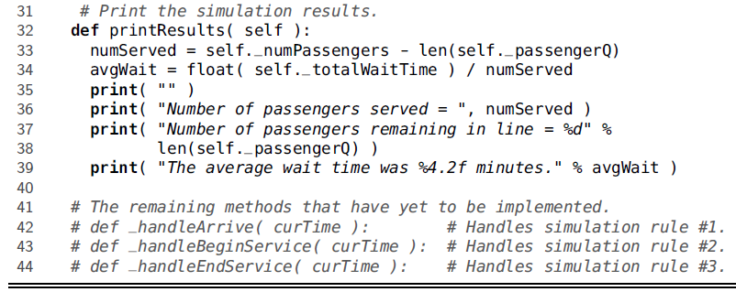
Application: Airline Ticket Counter

Slide 42
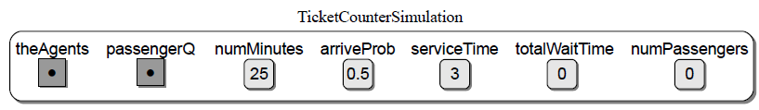
Application: Airline Ticket Counter

